Slide 1

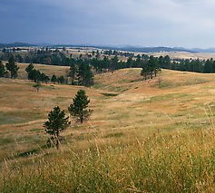
 | Lewiston Pistol Club, Inc Stage: Shoot From Behind The Barricade Course Designer: Roger Watson
START POSITION: Standing in Bianchi Barricade shooting box.
GUN READY CONDITION: Loaded gun in holster, hands relaxed at sides. |  | SCORING: Comstock, 16 rounds, 80 points TARGETS: 6 IPSC, 4 PP SCORED HITS: Best 2 per paper, KD steel = 1A START-STOP: Audible - Last shot RULES: USPSA current edition
STAGE PROCEDURE: Upon start signal, engage targets as required to score. Shooter must stay in shooting box.
LPC

